Slide 1



Diabetes eMarketing and RM:
Updated2013 Business Impact Projections
Prepared by Evolution Road
May 15, 2013

Slide 2
Purpose of Document
Provide Revised 2013 business impact projections based on lower conversion rate

Slide 3
An Important Note on These Analyses
These ROI projections and calculations are based on:
Januvia 2012/2013 performance projections per agencies
Januvia 2012 actual performance results YTD
Comscore eROI 2012 results and benchmarks
The Lifetime Values used in this analysis are Pre-tax and were provided by Merck Analytics 7/12

Slide 4
Diabetes eMarketing & Relationship
2013 Marketing Objectives
Activate prospects to ask HCP for JANUVIA or JANUMET XR
  Build brand awareness by engaging with patients online prior to seeing Doctor
  Encourage conversion with current SU users and increase awareness of potential negative SU side effects through laser targeted tactics
  Differentiate Januvia’s core attributes while building targeted brand awareness motivating Dr./Patient discussion
Engage current patients
  Ongoing relationship with patients on JANUVIA and JANUMET XR to develop brand loyalty and increase adherence

Slide 5

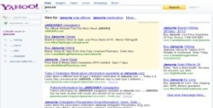
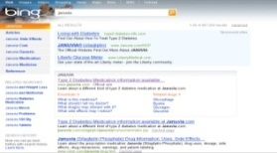


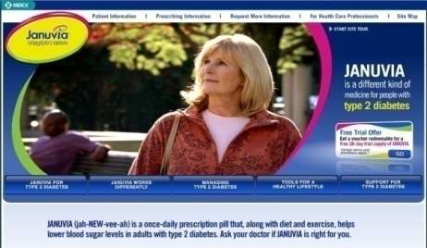





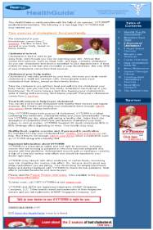

2013 Diabetes eMarketing and RM Strategic Approach
Paid Search
Drive qualified traffic to brand.com for education and activation
Display Media
Drive qualified traffic to brand.com for education and activation
RM/Lead Generation
3rd party Co-registration to drive to ongoing communications stream for education and activation/
Real Age Program
Drive conversion
Drive qualified prospects to Dr. to generate new patient starts
Encourage current patients to refill script

Slide 6
2013 Analysis Overview
2013 eMarketing Strategy:
Maximize revenue potential of proven business drivers
Optimize existing programs to improve business impact
Support Merck as leader in diabetes education through innovative program opportunities
Primary Activities
  Paid Search: English and Spanish Desktop, English Mobile
  Display Media: English and Spanish
  RM Program
  Real Age
  Other TBD pending additional program details (AdFlow, Wego, etc.)
Business Impacts
  Incr. New Patient Starts
  Incremental Refills
  Incremental Revenue
  ROI
  Scalability
Notes:
Add mobile paid search, organic traffic (desktop and mobile)

Slide 7
Comscore eROI Background
For Januvia, initial Comscore eROI study was undertaken for in 2009; subsequent studies were conducted in 2010/2011 and 2012/2013
  Positive performance results from the 2009 and 2010/11 studies has led to significant investments over the last several years in branded paid search, display media and the branded Web site for Januvia.com
2009 study showed statistically significant increases (above control) across awareness, intent and conversion metrics for paid search traffic
2010/2011 study did not have ample sample size to show statistically significant results for conversion metrics for paid search; however, conversion for total site visitors was on par with 2009 results, indicating support for continued investment
  Majority of traffic was driven from paid search so this indicated that paid search performance most likely on par with 2009 results

Slide 8
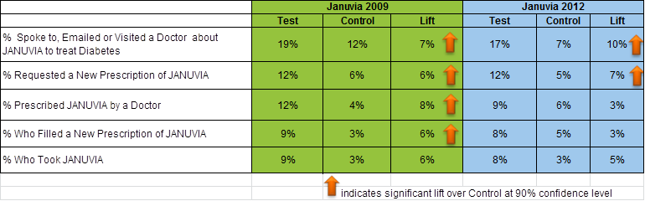
Comscore Januvia eROI Current Situation: Driving lower conversion in 2013 Projections
Initial 2012/2013 results show a lower lift in conversion, however, awareness and intent metrics show lifts on par with historical data
  Current test cells of “% prescribed” and “% who filled” directional, and not statistically significant
    Due to small sample size and small difference between test and control
Based on the data above, ER has revised the 2013 eROI projections utilizing a lower conversion rate

Slide 9
Updated Januvia 2013 Performance Projections
Januvia 2013 Full Year projections to deliver $121MM Incremental Revenue at a 8:1 ROI
Revised conversion rates resulted in an approx. 50% lower ROI and $107MM less incremental revenue than original projections (as of 1/13)
Paid Search: continues to be the main driver of ROI with an overall projected $92MM in incremental revenue at a 9.2 ROI
  Includes both Anglo and Hispanic Campaigns
Display: projected to deliver $12MM incremental revenue at a 3.6 ROI
  Includes both Anglo and Hispanic Campaigns
Real Age Program: projected to deliver $5MM incremental revenue at a 9.5 ROI in 2013
  Real Age program currently based on 1H 2012 results; to be updated pending actuals from 2H 2012 program
RM Program: The RM Lead Gen is projected to deliver $2MM incremental revenue at a 3.1 ROI

Slide 10
Updated Januvia 2013 Performance Projections
 | FY Projected Spend ($MM) | Projected ROI | Projected Incr. Rev ($MM)
2013 DIABETES CONSUMER E-MARKETING/RM TOTALS: | $14.7 | 8.3 | $121.8
JANUVIA Total | $14.6 | 8.3 | $121.1
Desktop Paid Search | $7.6 | 9.4 | $71.5
Mobile Paid Search | $0.7 | 6.0 | $4.2
National Hispanic Paid Search | $1.3 | 10.1 | $12.8
Local Hispanic Paid Search | $0.3 | 8.9 | $3.1
Display Media | $3.2 | 3.6 | $11.5
Hispanic Display Media | $0.3 | 1.0 | $0.3
RM Program | $0.5 | 3.1 | $1.6
Real Age | $0.5 | 9.5 | $4.7
Organic Traffic to Brand Site | $0.2 | 20+ | $11.3
JANUMET XR Paid Search | $0.0 | 20+ | $0.7

Slide 11
2013 Next Steps & Recommendations
Continue to explore further data insights from Comcore study to determine possible causes of drop in conversion
  Work with Comscore to determine if statistically significant results are feasible based on further sample collection
Continue to max out Paid Search as leader in delivering incremental revenue at scale
  Monitor ongoing A/B testing performance (initial results expected mid-May) to further optimize program
  Monitor performance of Google Display Network as separate program to determine scalability
  Monitor Hispanic paid search to determine scaleability
    Implement eROI study to gauge quality, intent and potentially conversion
  Confirm RM program structure and costs across brands

Slide 12
APPENDIX

Slide 13
Januvia 2013 Performance Projections
Januvia 2013 Full Year projections to deliver $238MM Incremental Revenue at a 18:1 ROI
Paid Search: continues to be the main driver of ROI with an overall projected $185MM in incremental revenue at a 20.5 ROI
  Desktop ROI projected lower than 2012 based on increased CPC and CPUV as projected by Draft
Display: projected to deliver $17MM incremental revenue at a 6.2 ROI
  Display ROI projected lower than 2012 based on increased CPC and CPUV as projected by Draft and decreased conversion rate projected for mobile display
RM Lead Gen: The RM Lead Gen is projected to deliver $2MM incremental revenue at a 3.8 ROI
Real Age Program: projected to deliver $4MM incremental revenue at a 8.8 ROI in 2013
 | FY Projected Spend ($MM) | Projected ROI | Projected Incr. Rev ($MM)
2013 DIABETES CONSUMER E-MARKETING/RM TOTALS: | $13.0 | 17.5 | $228.3
JANUVIA Paid Search Total (Mobile and Desktop) | $9.1 | 20.5 | $185.1
Paid Search Traffic to Brand Site | $7.8 | 21.6 | $167.5
Mobile Paid Search Traffic to Brand Site | $0.6 | 12.8 | $7.4
National Hispanic Paid Search Traffic to Hispanic Brand Site | $0.7 | 14.6 | $10.2
Display Traffic to Brand Site (Desktop & Mobile) | $2.8 | 6.2 | $17.1
RM Program Lead Gen | $0.5 | 3.8 | $1.9
Real Age | $0.5 | 8.8 | $4.4
Organic Traffic to Brand Site | $0.2 | 20+ | $15.8
JANUMET XR Paid Search | $0.1 | 20+ | $4.0

Slide 14
Revised Conversion Rates
Online Media Channel | Previous Conversion Rate | Revised Conversion Rate
Paid Search
Prospects | 7.0% | 3.0%
Patients | 8.0% | 3.2%
Display
Prospects | 2.0% | 1.3%
Patients | 8.0% | 5.0%
Organic Traffic
Prospects | 8.0% | 4.6%
Patients | 7.0% | 3.5%

Slide 15
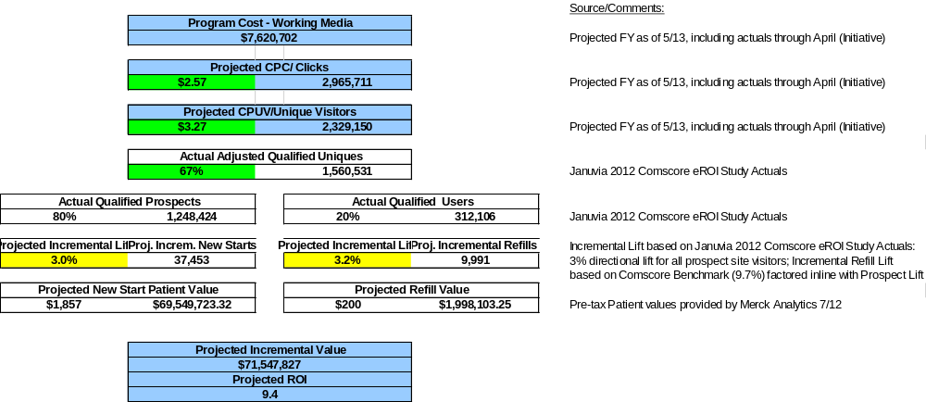
Januvia Desktop Paid Search

Slide 16
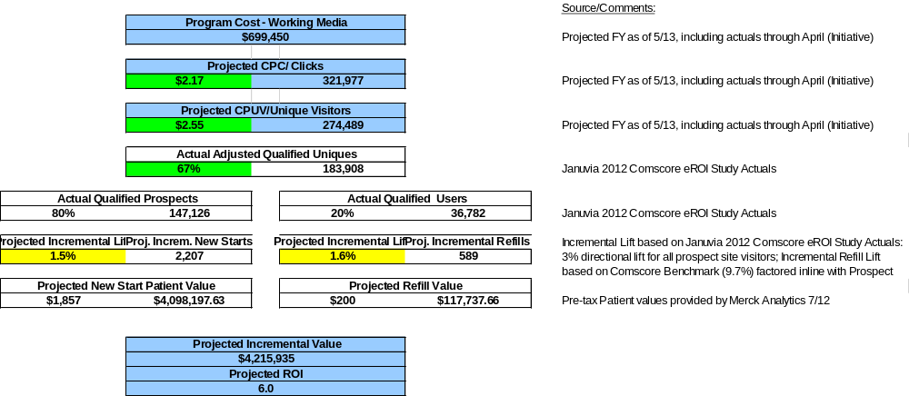
Januvia Mobile Paid Search

Slide 17
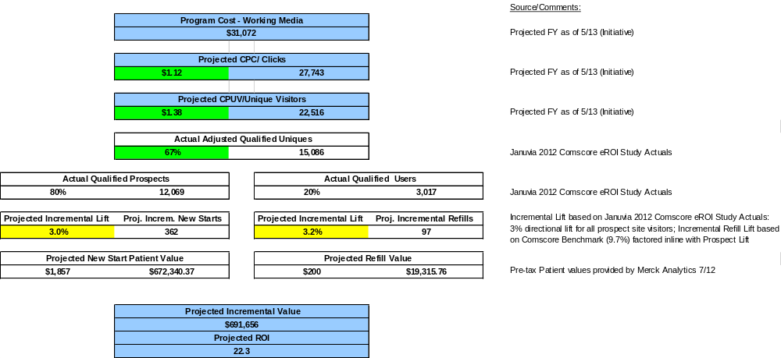
JanumetXR Desktop Paid Search

Slide 18
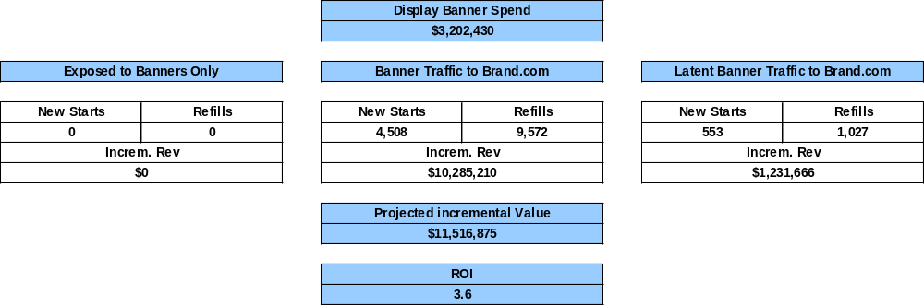
Januvia Display

Slide 19
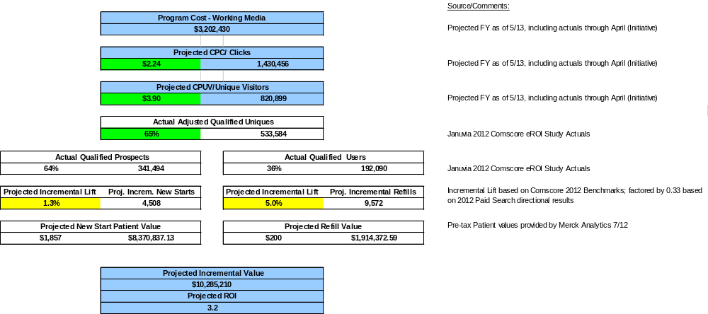
Januvia Display – Traffic to Brand.com

Slide 20
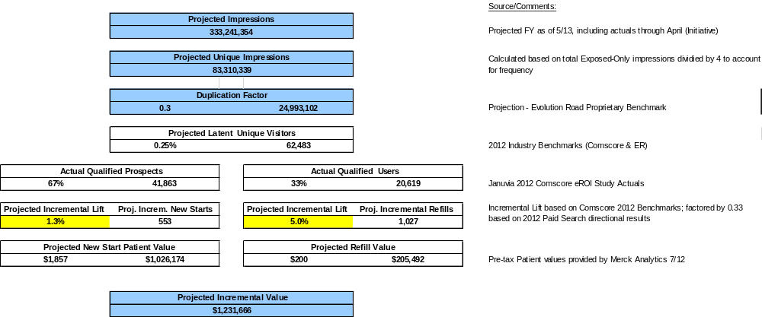
Januvia Display – Latent Banner Traffic

Slide 21
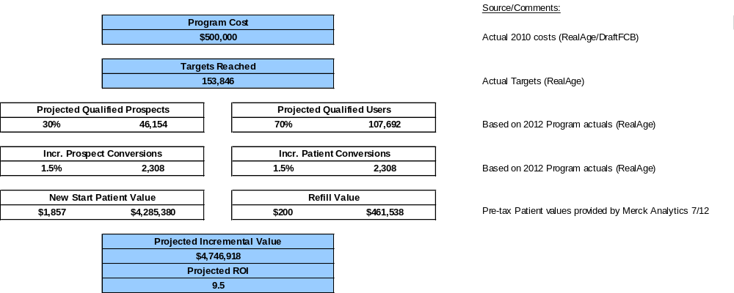
Real Age

Slide 22
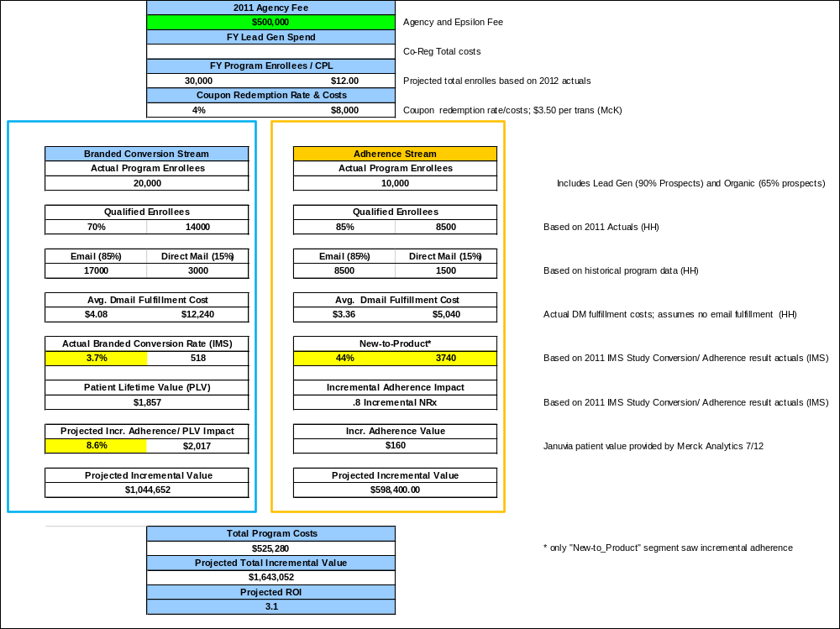
RM Program

Slide 23
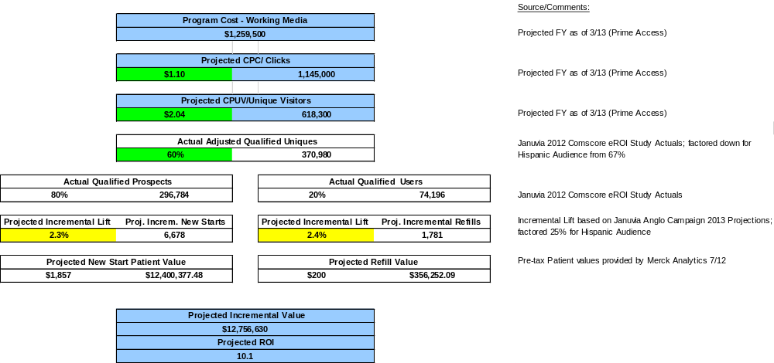
Hispanic National Paid Search

Slide 24
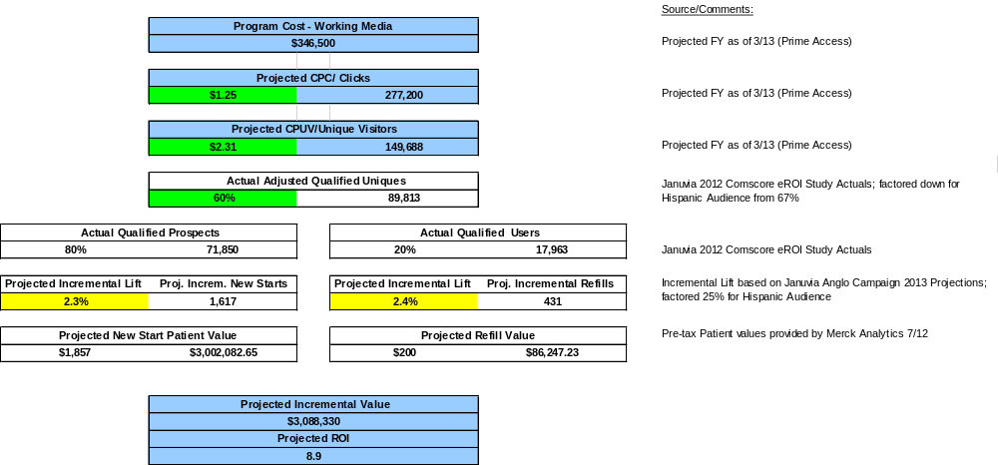
Local Hispanic Paid Search

Slide 25
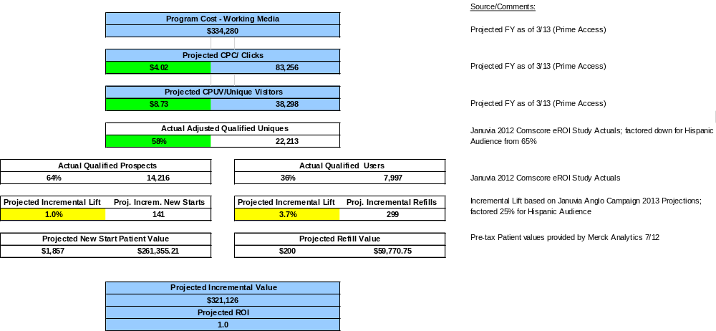
Hispanic Display

